Slide 1
Child Tax Credits - Nonrefundable Additional CTC – Refundable
Pub 4012 Tabs G
Pub 17 Chapter 47
(Federal 1040-Lines 52 & 67)
Notes:
1

Slide 2
Child Tax Credit (CTC)
Pub 4012 Tab G
Nonrefundable credit
Maximum credit per qualified child - $1,000
General Requirements:
Must meet Qualifying Child criteria
AGI & Filing Status determines amount, if any, of credit
TaxSlayer automatically completes Child Tax Credit Worksheet and transfers the calculated credit to 1040 line 52
Notes:
Note: There is also an Additional Child Tax Credit - a refundable credit
2

Slide 3
Child Tax Credit Qualifying Child Criteria
Pub 4012 Tab G
Claimed as taxpayer dependent:
Own child, step, adopted or foster child, or their descendants
Siblings, step brother/sister, half brother/sister or their descendants
Age: Under 17 on December 31 of tax year
Residency: lived with taxpayer over 6 months (exceptions discussed next)
Support: Child provided less than 50% of own support
US citizen or resident of US
Notes:
3

Slide 4
Exceptions To Residency
Born/died during tax year & lived with you for entire time he/she was alive
Temporary absences count as time lived at home – school, military, vacations, etc.
Children of divorced/separated parents:
See special rules in Pub 4012 Page G-9
Note: 2017 ruling says incarceration and institutionalized care for a child who is permanently and totally disabled are also considered as temporary absences (can be applied to any open tax years)
Notes:
4

Slide 5
Additional CTC Tax Credit
Refundable credit
Applicable for taxpayers who get less than full Child Tax Credit
This would occur if taxpayer’s tax liability is less than allowable CTC (which is nonrefundable)
Must have > $3,000 of taxable earned income to be eligible
Taxpayer with 3 or more children may be eligible for Additional Child Tax Credit regardless of income
Limited to 15% of earned income above $3,000
TaxSlayer automatically calculates Additional Child Tax Credit on Schedule 8812 and transfers to 1040 line 67T
Notes:
5

Slide 6
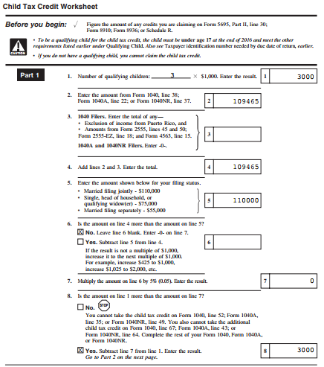
TS - Child Tax Credit Worksheet
TaxSlayer calculates this Worksheet automatically
Notes:
Sample Child Tax Credit Worksheet
Child Tax Credit shows the allowable CTC on Line 13. Since CTC is non-refundable, can only claim the amount of tax liability left after all earlier non-refundable credits on 1040 have been taken. Therefore, the claimed CTC may be less than maximum or even 0
TaxSlayer automatically completes this worksheet & transfers the total on Line 13 to 1040 Line 52
6

Slide 7
TS - Child Tax Credit – Federal 1040 Line 52
Total tax liability
TaxSlayer transfers from Child Tax Credit Worksheet Line 13
Notes:
TaxSlayer transfers the Child Tax Credit from the Child Tax Credit Worksheet Line 11 to 1040 Line 52
Notice that total of all nonrefundable credits (not just Child Tax Credit) on 1040 Line 56 cannot exceed total tax liability on Line 47
7

Slide 8
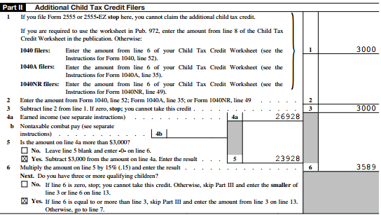
TS - Additional Child Tax Credit – Schedule 8812 Page 1
If not eligible for full nonrefundable Child Tax Credit (not enough remaining tax liability), TaxSlayer will calculate Additional Child Tax Credit on Schedule 8812
Notes:
Sample Form 8812 for the Additional Child Tax Credit. A family is not eligible for this credit if they received the maximum Child Tax Credit. Must also meet additional requirements discussed earlier
TaxSlayer automatically completes this worksheet
Total of Child Tax Credit + Additional Child Tax Credit cannot exceed $1,000 per child
8

Slide 9
TS - Additional Child Tax Credit – 1040 Line 67
TaxSlayer transfers from Schedule 8812 Line 13
Notes:
TaxSlayer transfers Form 8812 Line 13 to 1040 Line 67
9

